Slide 1

Chapter 3:
Pattern Discovery in Data Mining
Notes:
‹#›

Slide 2
Advanced Topics on Pattern Discovery
Objective
Brief overview of advanced topics in pattern discovery
Subgroup discovery, contrast pattern mining, emerging pattern mining, etc.
Cutting-edge research and emerging trends in pattern discovery
‹#›

Slide 3
Advanced Topics on Pattern Discovery
Challenges for Data Analysis in Data Streams
Data Streams
  Features: Continuous, ordered, changing, fast, huge volumn
  Contrast with traditional DBMS (finite, persistent data sets)
Characteristics
  Huge volumes of continuous data, possibly infinite
  Fast changing and requires fast, real-time response
  Data stream captures nicely our data processing needs of today
  Random access is expensive: single scan algorithm (can only have one look)
  Store only the summary of the data seen thus far
  Most stream data are at low-level and multi-dimensional in nature, needs multi-level and multi-dimensional processing
‹#›

Slide 4
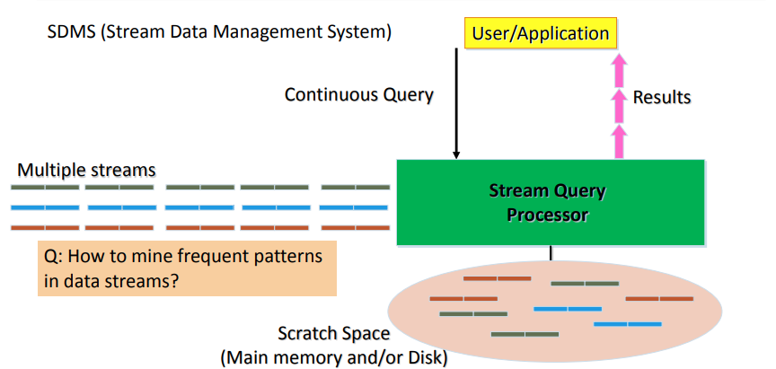
Advanced Topics on Pattern Discovery
Architecture: Stream Data Processing
‹#›

Slide 5
Advanced Topics on Pattern Discovery
Stream Data Mining Tasks
Stream mining vs. stream querying
  Stream mining shares many difficulties with stream querying
    E.g., single-scan, fast response, dynamic, …
    But often requires less “precision”, e.g., no join, grouping, sorting
  Patterns are hidden and more general than querying
Stream data mining tasks
  Pattern mining in data streams
  Multi-dimensional on-line analysis of streams
  Clustering data streams
  Classification of stream data
  Mining outliers and anomalies in stream data
‹#›

Slide 6
Advanced Topics on Pattern Discovery
Mining Approximate Frequent Patterns
Mining precise frequent patterns in stream data: Unrealistic
  Cannot even store them in a compressed form (e.g., FPtree)
Approximate answers are often sufficient for pattern analysis
  Ex.: A router
    is interested in all flows whose frequency is at least 1% (σ) of the entire traffic stream seen so far
    and feels that 1/10 of σ (ε = 0.1%) error is comfortable
How to mine frequent patterns with good approximation?
  Lossy Counting Algorithm (Manku & Motwani, VLDB’02)
    Major ideas: Not to keep the items with very low support count
    Advantage: Guaranteed error bound
    Disadvantage: Keeping a large set of traces
‹#›

Slide 7
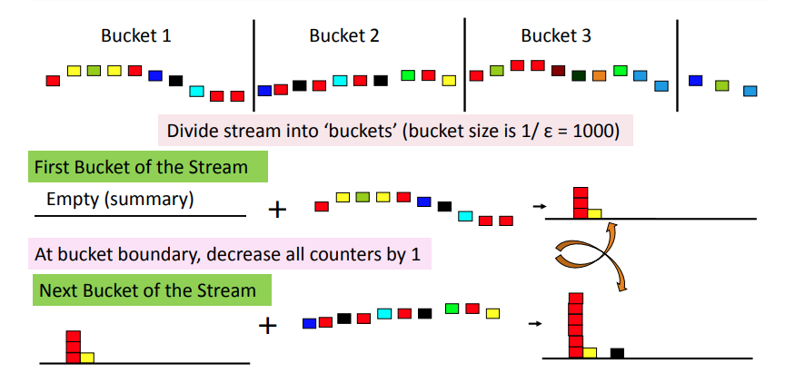
Advanced Topics on Pattern Discovery
Lossy Counting for Frequent Single Items
‹#›

Slide 8
Advanced Topics on Pattern Discovery
Approximation Guarantee
Given: (1) support threshold: σ, (2) error threshold: ε, and (3) stream length N
Output: items with frequency counts exceeding (σ – ε) N
How much do we undercount?
  If stream length seen so far = N and bucket-size = 1/ε then frequency count error ≤ # of buckets = N/bucket-size = N/(1/ε) = εN
Approximation guarantee
  No false negatives
  False positives have true frequency count at least (σ–ε)N
  Frequency count underestimated by at most εN
‹#›

Slide 9
Advanced Topics on Pattern Discovery
Other Issues and Recommended Readings
Other issues on pattern discovery in data streams
  Space-saving computation of frequent and top-k elements (Metwally, Agrawal, and El Abbadi, ICDT'05)
  Mining approximate frequent k-itemsets in data streams
  Mining sequential patterns in data streams
Recommended Readings
  G. Manku and R. Motwani, “Approximate Frequency Counts over Data Streams”, VLDB’02
  A. Metwally, D. Agrawal, and A. El Abbadi, “Efficient Computation of Frequent and Top-k Elements in Data Streams”, ICDT'05
‹#›

Slide 10
Advanced Topics on Pattern Discovery
Pattern Discovery for Software Bug Mining
Software is complex, and its runtime data is larger and more complex!
Finding bugs is challenging: Often no clear specifications or properties; need substantial human efforts in analyzing data
Software reliability analysis
  Static bug detection: Check the code
  Dynamic bug detection or testing: Run the code
  Debugging: Given symptoms or failures, pinpoint the bug locations in the code
Why pattern mining?—Code or running sequences contain hidden patterns
  Common patterns → likely specification or property
  Violations (anomalies comparing to patterns) → likely bugs
  Mining patterns to narrow down the scope of inspection
‹#›

Slide 11
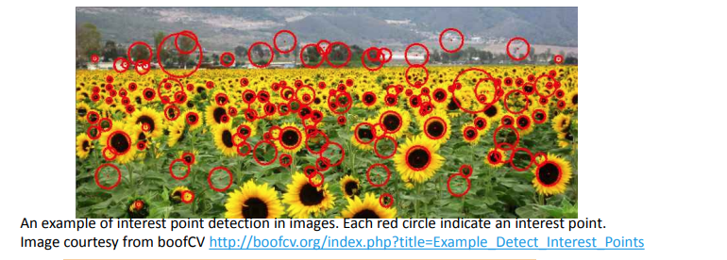
Advanced Topics on Pattern Discovery
Image Representation for Visual Pattern Discovery
An image can be characterized by visual primitives, e.g., interest points
  Each visual primitive can be described by visual feature, e.g., a highdimensional feature vector
  Each image is a collection of visual primitives
‹#›

Slide 12
Advanced Topics on Pattern Discovery
Pattern Mining and Society: Privacy Issues
A potential adverse side-effect of data mining—Privacy could be compromised
  Privacy and accuracy are typically contradictory in nature
  Improving one often incurs a cost on the other
Three categories on privacy issues arising out of data mining
  Input privacy (or data hiding)
    Distort or hide data to prevent the miners from reliably extracting confidential or private information
  Output privacy (or knowledge hiding)
    No disclosure of sensitive patterns or knowledge from datasets
  Owner privacy
    Does not allow any party to reliably learn the data or sensitive information that the other owners hold (i.e., the source of the data)
‹#›

Slide 13
Summary
Advance Pattern Discovery
Cutting-edge areas: Subgroup, contrast, emerging patterns.
Addressing complex data challenges.
Embracing evolving trends in research.
‹#›

